Slide 1
Securing Docker on the Cheap
Part 1 - Fundamentals

Slide 2
About Me
Possessor of many hats
Currently at LO3 Energy
Formerly of Autodesk
This talk brought to you by the letter ‘A’
Notes:
A bit of a generalist, with experience in development, sysadmin, architecture, security, and even tech support.
Currently at LO3 Energy - a block-chain powered energy microgrid startup
Began working with containers while Autodesk, where I design and implement on a SOC2 compliant Docker based service
Much of this presentation is inspired by work on Docker security and compliance efforts at Autodesk

Slide 3
But first….

Slide 4
The whale in the room
Notes:
This talk is focused on Docker container technologies. The speaker fully acknowledges that not a all containers are Docker containers.
Part 1 is mostly about what you can do with Docker itself.

Slide 5
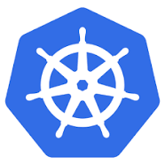
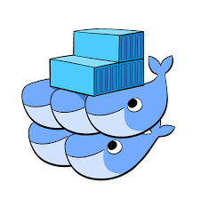

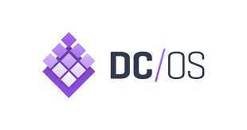

Orchestration platform agnostic
Notes:
This presentation does not assume any particular orchestration solution, or any orchestration at all. While how these techniques are leveraged may vary depending on the orchestration platform, they use primarily what Docker does out-of-the-box.

Slide 6
No experience required.
Notes:
Part 1 assumes no prior experience with Docker or containers in general.
Parts 2 and 3 will require some prior knowledge of Docker, which can be obtained in Part 1.

Slide 7
Docker 101
Notes:
To level set, let’s begin with an introduction to containers and Docker.

Slide 8
What is a container?
Notes:
A container is really just a special kind of process in Linux which is isolated from other processes and resources on a Linux host. Current generation of containers use a collection of kernel features, notably
Namespaces
Control Groups
seccomp

Slide 9
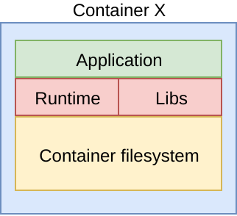
Perfect Packaging
Everything needed for execution of the container is packaged together
  Application code
  Runtime environment
  Dependency libraries
  Even root filesystem
Container “package” can be delivered to any host capable of executing that container
Notes:
This is an oversimplification, but generally conveys core idea of what a container is. How the container is packaged, managed, distributed, deployed, and run can vary depending on container technology.

Slide 10
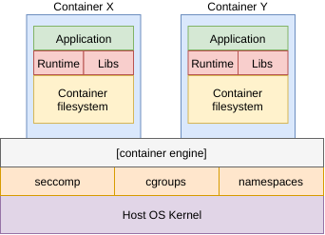
Intrinsic Isolation
Pseudo-virtualization
Isolated resources on top a of shared host kernel
Container engine (LXC, Docker, etc.)
Leverages control groups for resource allocation
Namespaces provide isolation
Has roots in chroot and FreeBSD jails
Notes:
Containers are a pseudo-virtualized, which is a fancy way of staying they’re kinda like a virtual machine, only not a complete machine.
They are an isolated set of processes and filesystem which run in their own namespace on a host kernel.
The container engine provides a shim for running the isolated resources on the host kernel.
Cgroups are used to manage how resources are allocated. They can also be used to enforce “fair play” on a container host.
Namespaces ensure the process execution inside the container does not clash (or interfere) with the host. Specifically that user actions inside the container execute in the container local namespace, so that events within the container cannot impact the host. For example a container process running as UID 0 in the container does not run as UID 0 on the host.
Note: this presentation is not a history lesson on containers.
Control groups: https://access.redhat.com/documentation/en-us/red_hat_enterprise_linux/6/html/resource_management_guide/ch01
Namespaces: https://lwn.net/Articles/528078/

Slide 11
Why Docker?

Slide 12
Containers made easy
Notes:
Containers had already been around for a while (LXC was 2008, but Solaris Zones[2004], FreeBSD Jails [2000] go back even further) by the time Docker arrived on the scene in 2013. But Docker provided what developers really hungered for: a simple, useful toolkit and ecosystem for building, distributing, and running containers. Simply put, they cracked the portability problem.
https://blog.aquasec.com/a-brief-history-of-containers-from-1970s-chroot-to-docker-2016

Slide 13
Adoption
Notes:
Because of it’s amazing portability and ease of use, Docker has become a near de-facto standard for containers.
Sure, not every container is a Docker container, in the same way that not every flying disk is a Frisbee.

Slide 14
Security Fundamentals

Slide 15
First...
Notes:
Let’s clarify a couple of classifications of containers and how they apply security principles.

Slide 16
Service Containers vs
Tool Containers
Notes:
Generally containers can be classified into 2 categories:
Service Container
Tool Container
A service container is a container designed to host some perpetually running service (web server, app server, database engine, etc.). These containers work more like traditional physical or virtual servers. Most of the security principles in this presentation and it’s follow-on parts apply more strongly to service containers.
Tool containers wrap Docker around a tool which is single-purposed and (relatively) short execution. Examples include application CLIs, batch scripts, and build toolchains. Some of the security principles either do not apply to these containers, or have more “wiggle room” in their implementation.
As with anything, consider the effort required to harden, maintain, and use when planning your security guidelines for containers.

Slide 17
Security Starts at the Top
Notes:
One of the most basic, yet most effective security principles. To better understand, let’s take a look at a sample Dockerfile.

Slide 18
Sample Dockerfile
FROM ubuntu:16.04
RUN apt update && apt upgrade -y && apt install -y curl && \
curl -sL https://deb.nodesource.com/setup_8.x | bash - && \
apt install -y nodejs
EXPOSE 3000
ADD app.js /var/app/
ADD package.json /var/app/
WORKDIR /var/app
RUN npm install
CMD ["/usr/bin/node", "app.js"]
Notes:
This sample Dockerfile creates a simple Node/Express app using an Ubuntu 16.04 base.
There are few security issues with this Dockerfile, but we will, as previous stated, start at the top.

Slide 19
Know your FROM
Notes:
This simple line can make a big difference in the security posture of services running on your container.
Let’s see why...

Slide 20
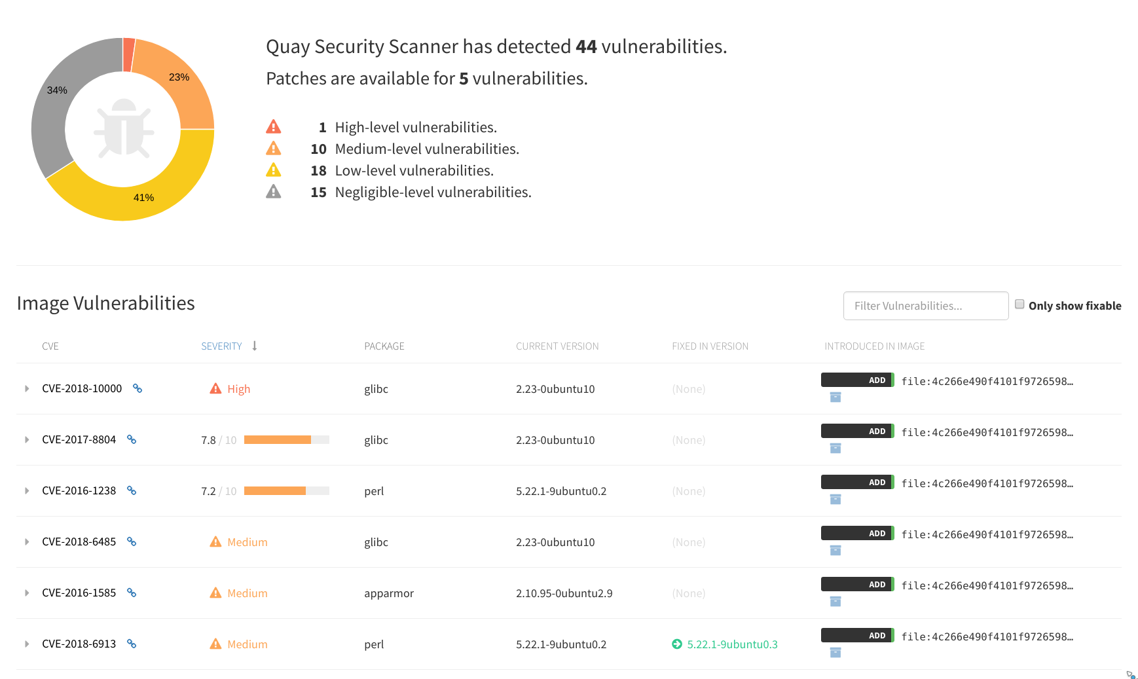
Security scan of ubuntu:16.04
Notes:
Quay.io (from the CoreOS folks) includes vulnerability scanning as part of its service. This is the vulnerability scan result for the base ubuntu:16.04 image.
It gets worse….

Slide 21
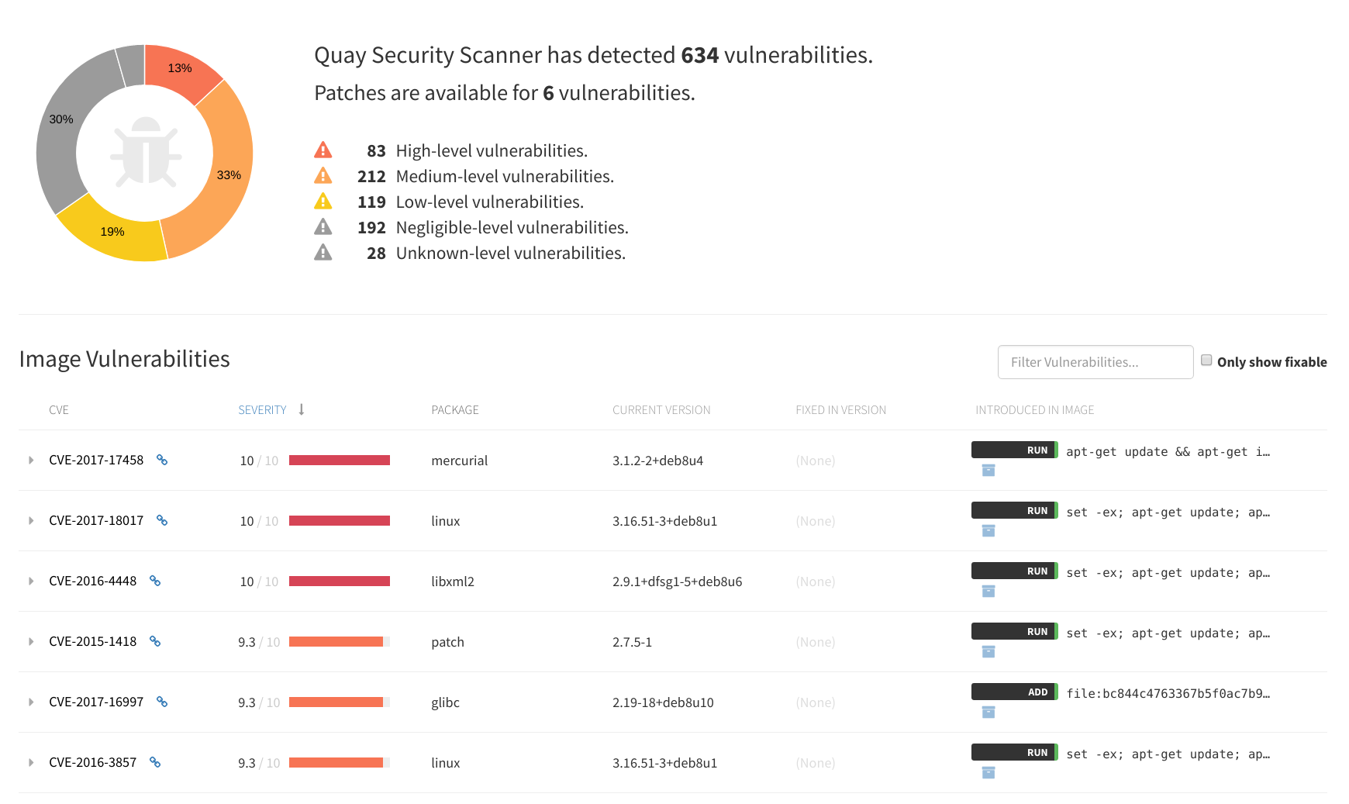
Security scan of node:9.11.1
Notes:
Yikes! This happens to be the latest (as of 2018-04-16).
If you’re building your container using FROM node and pulling this container from Docker Hub, you’re inheriting ALL OF THIS.
So, how do you get around this? Knowing, as they say, is half the battle. The other half of this particular battle: use your own base container for your services.

Slide 22
Creating a Custom Base Container
Notes:
Let’s review some rules for creating a custom base

Slide 23
Rules for a Quality Custom Base
Starting tiny is better
Patch as part of the build
Build a shared service base
  Install common tools
  Install base runtime
Leave the application specifics for downstream containers
Leverage any hardening standards/tools for the OS
Install only what you need
Leave build tools on build containers
Pro-tip: docker run -it [base-image]:[tag] /bin/sh to experiment
Notes:
When deriving from a public base, start with the smallest possible. Not only does this keep your container image smaller, but the smaller Linuxes tend to pre-load less bloat.
One note about tiny bases: they may work differently than the Linuxes you’re used to. Take some time to explore.
Add a patching RUN command in the Dockerfile for the base build, so everytime the base is rebuilt, it automatically installs the latest patches.
You’ll get more out of your time if you create one common base for all of your similar applications. Create a node-base for all of your Node work. Create a ruby-base for all of your Ruby work.
Pro-tip: experiment with the container build commands by running the base container interactive locally. This allow you to test all of the commands for the Dockerfile without having to build.

Slide 24
Scratch Containers
Docker images can be derived from tarballs
Docker containers need a filesystem
...but that does not need to be a full base OS filesystem
Docker images can be built directly
FROM scratch
Statically-linked executables (like Go) can be built directly into Docker images

Slide 25
Capabilities
Notes:
Docker allows your to holistically add or remove Linux kernel capabilities from a container execution.
http://man7.org/linux/man-pages/man7/capabilities.7.html

Slide 26
Removing Capabilities
Notes:
Capabilities can be removed with the --cap-drop option, providing one or more Linux capabilities as a list.

Slide 27
docker run --cap-drop SETUID --cap-drop CHOWN ubuntu
Notes:
Take a look at this example. We’ve removed 2 capabilities: setuid and chown. With these set, processes in the container namespace will not be able to change users or change ownership of files. If used correctly, this could be used to prevent privilege execution within a container.

Slide 28
Adding Capabilities
Notes:
Just as capabilities can be removed, they can also be added.

Slide 29
docker run --cap-add RAW_IO
Notes:
Take a look at this example. We’ve removed 2 capabilities: setuid and chown. With these set, processes in the container namespace will not be able to change users or change ownership of files. If used correctly, this could be used to prevent privilege execution within a container.

Slide 30
https://github.com/moby/moby/blob/master/oci/defaults.go func defaultCapabilities() []string { return []string{
"CAP_CHOWN", "CAP_DAC_OVERRIDE", "CAP_FSETID",
"CAP_FOWNER", "CAP_MKNOD", "CAP_NET_RAW",
"CAP_SETGID", "CAP_SETUID", "CAP_SETFCAP",
"CAP_SETPCAP", "CAP_NET_BIND_SERVICE",
"CAP_SYS_CHROOT", "CAP_KILL", "CAP_AUDIT_WRITE",
}
}
Notes:
By default Docker denies all capabilities, and whitelists the capabilities listed above. These are “general purpose” defaults, however, and depending on the use case even this limited set may be more liberal actually required.

Slide 31
Secure Computing Mode (seccomp)
Notes:
Secure computing mode (seccomp) is a Linux kernel feature for managing which syscalls are allowed or disallowed. Docker Engine whitelists a sizeable subset of the 300+ available syscalls, but similarly to capabilities, there may be more allowed than are actually required in the default set. Docker can take a profile of allowed syscalls (specified in a json file) to further limit the allowed actions.
Some of the syscalls overlap with capabilities.

Slide 32
https://github.com/moby/moby/blob/master/profiles/seccomp/default.json
{
“defaultAction”: “SCMP_ACT_ERRNO”,
“archMap”: [],
“syscalls: [
{
“names”: [ “chdir”, “chmod”, … ],
“action”: “SCMP_ACT_ALLOW”,
“args”: [],
“comment”: “”,
“includes”: {},
“excludes”: {}
}
]
}
Notes:
When starting with seccomp profiles, begin with the default profile from Docker, and add/remove as necessary.
Default action SCM_ACT_ERRNO causes all actions to be denied with a “Permission denied” error, except for those explicitly allowed.
archMap maps architecture names which can be used later to allow or deny depending on the architecture.
Then comes collections of syscalls, along with their actions, and metadata related to the call.

Slide 33
docker run --security-opt seccomp=/path/to/profile.json ubuntu: 16.04
Notes:
Take a look at this example. Using the option --security-opt we’re specifying a path on the host to a custom profile for the container.

Slide 34
Immutable Containers docker run --read-only \
--tmpfs /tmp:rw,noexec,nosuid \
-v /host/path:/app/workdir [image]
Notes:
Docker makes it really easy to run containers immutably. Which is great for preventing attacks against the container which are some form of
Compromise service
Make it pull malware from remote source
Run malware in container
The --read-only option makes the entire container filesystem read-only. Trying to write any file, anywhere in the container (including /tmp) will fail with a “read-only filesystem” error.
If your container needs a working temp space, you can mount temporary directories with a --tmpfs option, which takes a path in the container, along with mount options.
The example here runs a container with a read-only filesystem, and replaces the default /tmp for this environment with a mounted writeable tmpfs mount, but minus execute and suid.
A note about mounted volumes. By default any volume mounted is writeable within the container, ignoring the read-only option. So you can have your read-only filesystem and persistent storage, too.

Slide 35
Control Groups
(cgroups)

Slide 36
Ok, what are control groups?
Notes:
Control groups are a feature of the Linux kernel to manage resources allocated to processes. They allow you to define a group with resource allocation budgets and assign processes to those groups to work within that group’s budget.
These include CPU, memory, disk and network I/O. Also included is the ability to monitor process resource utilization.
This this isn’t strictly security in the way that capabilities and seccomp profiles are, they do provide an additional layer of protect by preventing run-away processes from causing localized denial of service.

Slide 37
Docker && cgroups
Notes:
Docker engine does a lot of the heavy lifting on control groups for you. Docker engine provides a default parent control group (/docker for filesystem and system.slice for systemd). When a container is launched, it automatically creates a context for that container if the parent cgroup (which is given the same name as the full container ID).
You can change the cgroup for a container entirely if desired with the --cgroup-parent option. There are also several options to directly manipulate cgroup limits.

Slide 38
Some cgroup Options
--cpu*
--blkio*
--device*
--memory* https://docs.docker.com/engine/reference/commandline/run/#options
Notes:
There are lots of direct cgroup options available to Docker containers to apply resource budgets to a container. When Docker runs the container with these options set, it will put that container in a control group automatically with the appropriate limits applied.

Slide 39
Other Tips

Slide 40
Don’t run as root
Notes:
Don’t run things as root in the container; namespaces prevent root in the container from being root on the host, but compromise on the a service running as root within a container still has the potential to be damaging inside the container namespace.
In other words, don’t let your container become someone’s cryptominer.

Slide 41
Avoid --privileged
Notes:
When a container runs a privileged, it gets special access to resources on the host.
It breaks namespaces
Don’t do it
This also applies to another form of privileged --net=host
Example somewhat legit use is for security monitoring systems which need to audit behavior of other containers on the host
Even then these could run without being privileged, just add the capabilities they truly need

Slide 42
Be intentional

Slide 43
Wrap-up
https://github.com/fork4/lfnw2018
Notes:
Many orchestration framework use these features as part of their container deployment, but attempt to express them in more human-readable ways. Now you may have a better understanding how they are doing limits or locking down containers. Everything shown here, except for the vulnerability scan results in Quay, uses features built in to, or are practices applied to, freely available Docker and Docker Engine.

